Slide 1


Create a Simple Bitcoin Wallet in C#
Working with HD Wallet, Public Keys, Addresses, Private Keys, Mnemonic Phrases, Transactions
Svetlin Nakov
Technical Trainer
Academy School of Blockchain
http://kingsland.academy

Slide 2
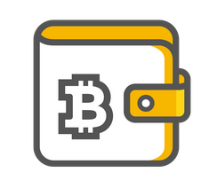

Table of Contents
Wallet's Functionality
Create a New Wallet
Recover by Mnemonic Phrase
Check Account Balance
View Account History
Receive Bitcoins
Send Bitcoin Transactions

Slide 3
Tools
The wallet software will be built using:
C# and .NET Core
HBitcoin – high level C# Bitcoin wallet library
https://www.nuget.org/packages/HBitcoin
QBitNinja – an open source and powerful blockchain API
https://www.nuget.org/packages/QBitNinja.Client

Slide 4
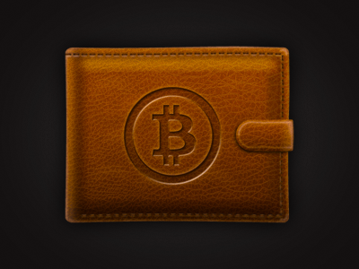
Bitcoin Wallet
JSON File, Addresses

Slide 5
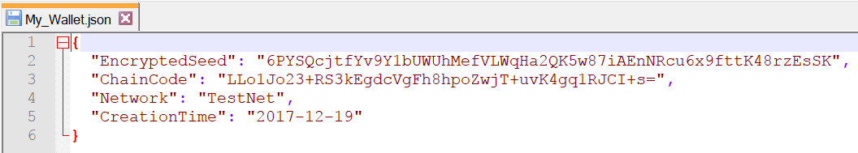
What is a Bitcoin Wallet?
A simple .JSON file / other file holding a seed key
Might be password protected
Created by a mnemonic phrase or randomly generated
Drives multiple public-private key pairs

Slide 6
Public / Private Keys, Wallets & Blockchain
wallet root key (seed)
private key
public key
address
signed transaction
transaction data
transaction
sign by private key
public key: (x, y)
signature: (r, s)
signed transaction
verify by public key
valid / invalid

Slide 7
Public Keys
Think of addresses as compartments of a real wallet
Keep track of transactions
Can be visible with everyone

Slide 8
Privatе Keys
Every public address has a corresponding private key
Should be well hidden
Used to sign transactions (send coins)
Looks like this:

Slide 9
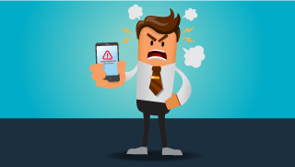
Wallet Recovery

Slide 10

Recover a Wallet
To recover a lost wallet from a backup you need:
Mnemonic phrase (12 / 24 words)
Password (to protect the mnemonic phrase)
Both known only at creation time
Most wallets are based on the HD wallets standards
BIP39 – from mnemonic to seed
BIP44 – hierarchical key derivation

Slide 11
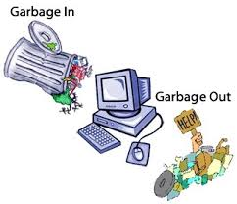
Mnemonic Phrase and Password
Wrong mnemonic phrase / password generates different wallet
Exception is thrown if a non-word is used
Non-word == not in the English dictionary

Slide 12
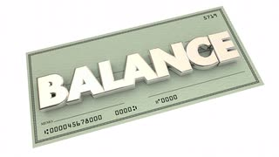
Balance of a Wallet

Slide 13
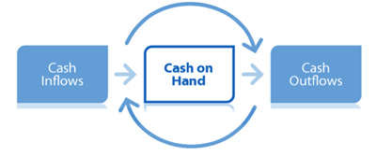
Balance Calculation
Addresses keep track of all transactions
Transactions have an amount and flow
The sum of all amounts gives the total balance of the wallet

Slide 14
Transaction ID
Inputs (including signature data) and the outputs are added together and hashed
Inputs == transaction(s) proving available Bitcoins to spend
Outputs == destination public address and change address

Slide 15
Inputs
Outputs transform into inputs in the following transactions
Transactions are themselves chained
Protection against double spending
If inputs > outputs, the transaction is rejected

Slide 16
Outputs
Outputs == all Bitcoins from selected as Inputs transactions
Change reduces the amount send by returning the specified amount to sender
Amount received == Inputs – Outputs – Change – Miner’s fee
Change can then be used by the sender as an input in another transaction

Slide 17

History of Transactions

Slide 18
Transaction ID
Every transaction has a unique ID
Having a history of all transactions gives access to this information
In order to spend Bitcoins a transaction ID with inflow of Bitcoins must be used
Every transaction with inflow of Bitcoin is an outflow when Bitcoins are spend

Slide 19
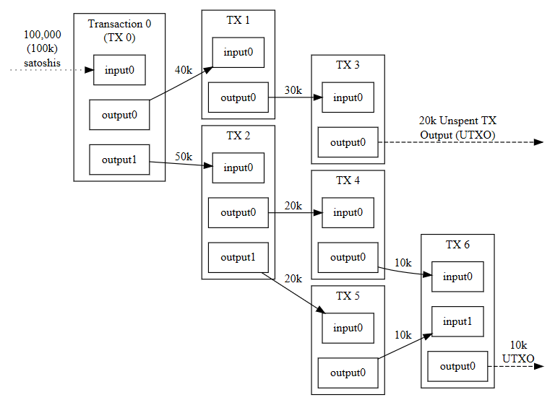
Bitcoin: TX Input & Output

Slide 20
Notation
TX – stands for transaction
UTXO – stands for Unspent Transaction Outputs
Represent available Bitcoins to be spent
Output are tied to transaction ID, which are hashes of signed transactions

Slide 21
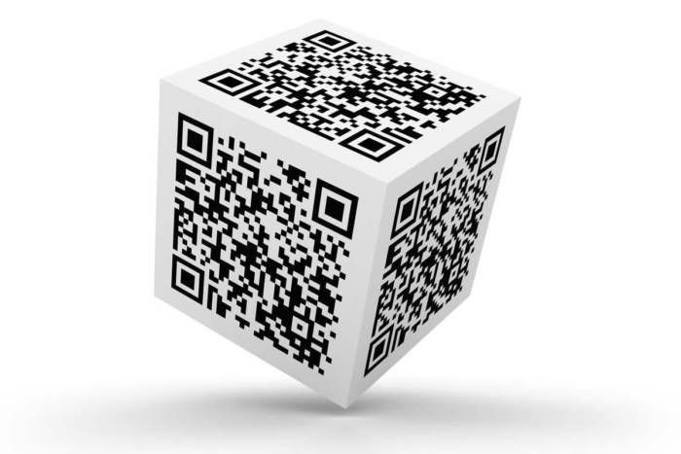
Public Addresses / Receive Bitcoins

Slide 22
Use of Public Addresses
They receive the Bitcoins sent from someone else
You need a public address
You wallet generates private key → public key → address
For privacy / anonymity reasons
It is possible to generate new public address for each inflow transaction

Slide 23
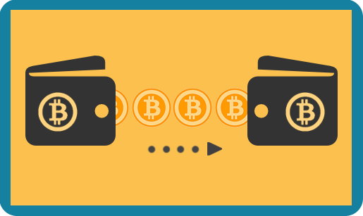
Sending Bitcoins

Slide 24
How to Send Bitcoins?
Choose the address you want to send Bitcoins from
Choose the transaction ID from which Bitcoins will be sent
Choose the amount to be sent
Choose the amount to be got back
Example of a transaction done by hand on the Main network
https://www.youtube.com/watch?v=X4ZwRWIF49w

Slide 25
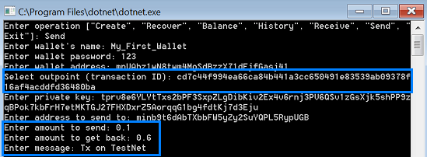
Transaction Inputs

Slide 26
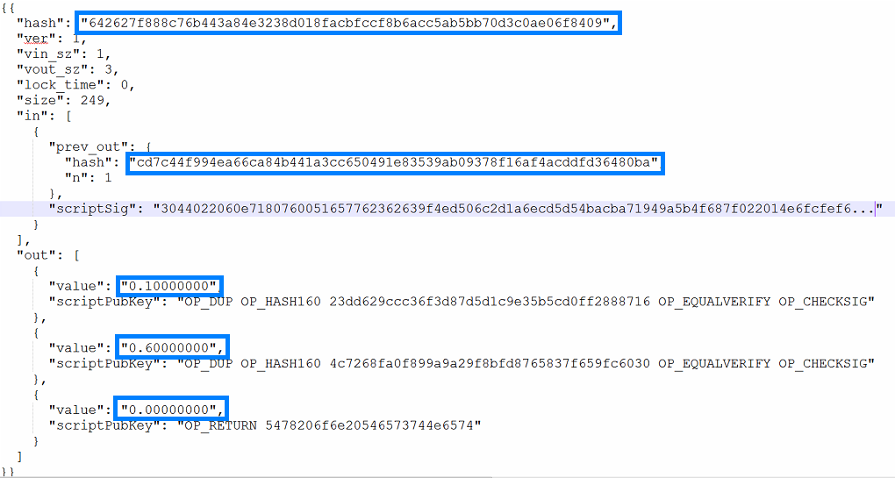
Transaction Contents

Slide 27
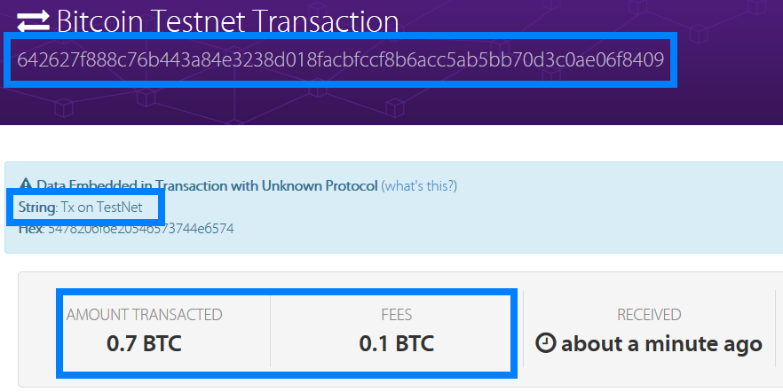
Transaction Results

Slide 28

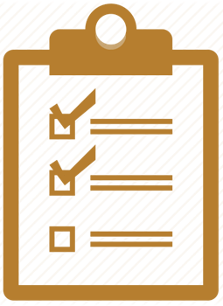
Summary
Basic functionality of a simple Bitcoin wallet
Based on NBitcoin and HBitcoin libraries
Relationships between functionalities
Inner working of transactions

Slide 29
Create a Simple Bitcoin Wallet in C#
http://www.kingsland.academy

Slide 30
Resources
Programming the Blockchain in C# - https://www.gitbook.com/book/programmingblockchain/programmingblockchain/details
NBitcoin: How to make your first transaction with Nbitcoin - https://www.youtube.com/watch?v=X4ZwRWIF49w
Build Your Own Bitcoin Wallet - https://www.codeproject.com/Articles/1115639/Build-your-own-Bitcoin-wallet
Bitcoin Developer Guide - https://bitcoin.org/en/developer-guide

